Slide 1



Department of Computer Science and Engineering
INTRUSION DETECTION PREDICTION USING DATA SCIENCE TECHNIQUE
KARTHICK ARAVIND B [211419104318]
T. PENIEL BRANHAM [211419104321]
BALAMURUGAN S [211419104036]
Mr.THYAGARAJAN.C M.E.,(Ph.D),
ASSISTANT PROFESSOR
Dr.N.PUGHAZENDI M.E., Ph.D.,
PROFESSOR

Slide 2
Introduction
Intrusion Detection Systems are designed to safeguard the security needs of enterprise networks against cyber-attacks. However, networks suffer from several limitations, such as generating a high volume of low-quality alerts. The study has reviewed the state-of-the-art cyber-attack prediction based on Intrusion Alert, its models, and limitations. The ever-increasing frequency and intensity of intrusion attacks on computer networks worldwide intense research efforts towards the design of attack detection and prediction mechanisms. While there are a variety of intrusion detection solutions available, the prediction of network intrusion events is still under active investigation. Over the past, statistical methods have dominated the design of attack prediction methods. The analysis of dataset by supervised machine learning technique(SMLT) to capture several information’s like, variable identification, univariate analysis, bivariate and multivariate analysis, missing value treatments etc. A comparative study between machine learning algorithms had been carried out in order to determine which algorithm is the most accurate in predicting the type cyber attacks. The results show that the effectiveness of the proposed machine learning algorithm technique can be compared with best accuracy, precision, Recall, F1 Score, Sensitivity, and Specificity.

Slide 3
Objective of the Project
The main objective of this project is to develop a machine learning model for intrusion detection Prediction, to potentially replace the updatable supervised machine learning classification models by predicting results in the form of best accuracy by comparing supervised algorithm. The scope of the project is that an IPS prevents attacks by dropping malicious packets, blocking offending IPs and alerting security personnel to potential threats. Such a system usually uses a pre-existing database for signature recognition and can be programmed to recognize attacks based on traffic and behavioral anomalies. An Intrusion Detection System (IDS) is a monitoring system that detects suspicious activities and generates alerts when they are detected. Based upon these alerts, it is necessary to know the attack type. So, the security operations center (SOC) analyst or incident responder can investigate the issue and take the appropriate actions to remediate the threat.

Slide 4
Literature Survey
Title : An Intrusion Detection Method Based on Machine Learning and State Observer for Train-Ground Communication Systems
Author: Bing Gao, Bing Bu, Wei Zhang, Xiang Li (2022)
This paper proposes an intrusion detection method to ensure the information security of the train-ground communication system in urban rail transit. The communication-based train control system (CBTC) uses wireless communication protocols to transmit control commands, but faces potential security risks. The proposed method uses machine learning and state observer to detect and recognize various attacks, including anomalies of wireless network data and train physical states. The detection system includes two layers: one to detect and identify wireless network attacks using machine learning algorithms, and another to detect abnormal physical state of train operation. The results of both layers are combined to give a comprehensive intrusion detection result. Simulation results show that the proposed method is effective and practical.

Slide 5
Literature Survey
Title : Early Detection of Network Intrusions Using a GAN-Based One-Class Classifier
Author: Taehoon Kim, Wooguil Pak (2022)
Detecting network intrusions early is crucial for network security. Most current methods use features for full sessions, making early detection difficult. The proposed method uses packet data as features to determine malicious traffic. This can lead to false detections, so the proposed method learns patterns of unhelpful packets to improve classification. A new training dataset for Generative Adversarial Network (GAN) is created using misclassified data from an original training dataset by the LSTM-DNN model. The GAN can determine if a packet can be classified accurately and cancels detection if not. The proposed algorithm can accurately perform network intrusion detection in real time without session termination or delay time. Experiments confirm early detection before session end while maintaining similar detection performance to existing methods.

Slide 6
Literature Survey
Title : Detecting Zero-Day Intrusion Attacks Using Semi-Supervised Machine Learning Approaches
Author: Mbona, Jan H. P. Eloff (2022)
Zero-day attacks are a frequent cybersecurity threat that can exploit network system vulnerabilities for prolonged periods. Network traffic analysis (NTA) plays a crucial role in supporting machine learning (ML) based network intrusion detection systems (NIDS). However, most existing ML models for NIDS employ redundant features that negatively impact performance. Benford's law is a viable technique that can effectively identify significant network features indicative of anomalous behavior and detect zero-day attacks. Semi-supervised ML approaches are effective for detecting zero-day attacks if significant features are optimally chosen. Experimental results demonstrate that one-class support vector machines achieved the best results for detecting zero-day network attacks (Matthews correlation coefficient of 74% and F1 score of 85%).

Slide 7
Problem Statement
The problem Statement for the proposed model to build a machine learning model for anomaly detection is to develop a reliable and efficient system that can accurately identify and detect fraudulent activities, suspicious activities, network intrusions, and other abnormal events that are challenging to detect. The model should apply appropriate data science techniques such as variable identification, data preprocessing, and visualization to build a model based on a previous dataset where the algorithm learns and gets trained using various algorithms for better comparisons. The goal is to evaluate the performance metrics of the model and compare them to select the most appropriate algorithm for anomaly detection. The proposed model aims to contribute to the development of an efficient and effective anomaly detection system that can help organizations prevent security breaches and protect their critical assets and data from potential threats.

Slide 8
Proposed System
The proposed model is to build a machine learning model for anomaly detection. Anomaly detection is an important technique for recognizing fraud activities, suspicious activities, network intrusion, and other abnormal events that may have great significance but are difficult to detect. The machine learning model is built by applying proper data science techniques like variable identification which is the dependent and independent variables. Then the pre-processing and visualization of the data is done. The model is build based on the previous dataset where the algorithm learn data and get trained different algorithms are used for better comparisons. The performance metrics are calculated and compared.

Slide 9
Software / Hardware used
1. Software Requirements:
Operating System : Windows 10 or later
Tool : Anaconda with Jupyter Notebook
2. Hardware requirements:
Processor : Intel i3
Hard disk : minimum 80 GB
RAM : minimum 2 GB

Slide 10
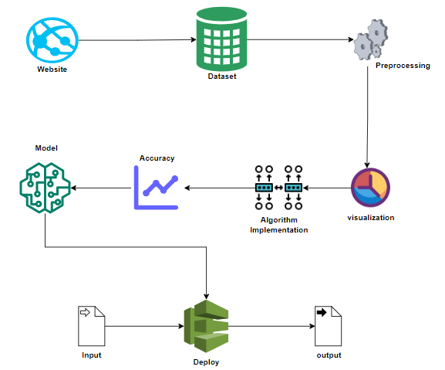
Architecture / Methodology used

Slide 11
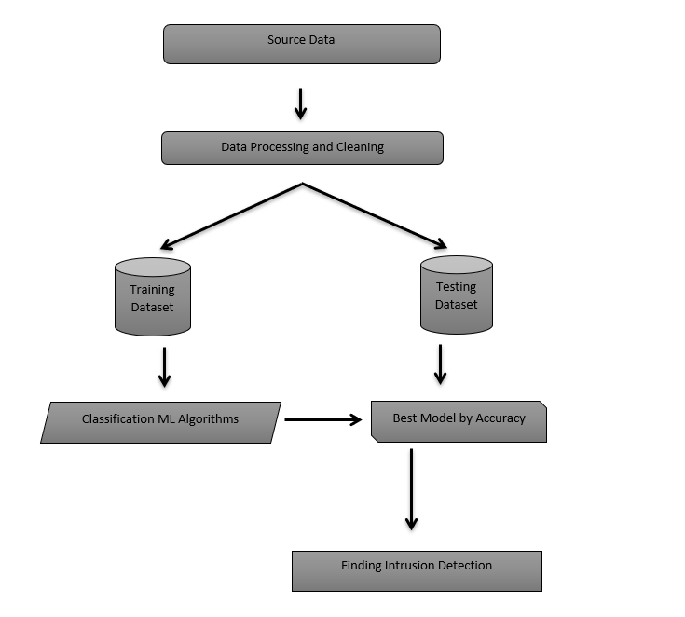
System Design
Flow Chart :

Slide 12
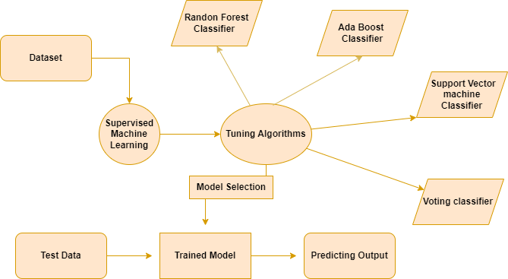
System Design
Entity relationship diagram :

Slide 13
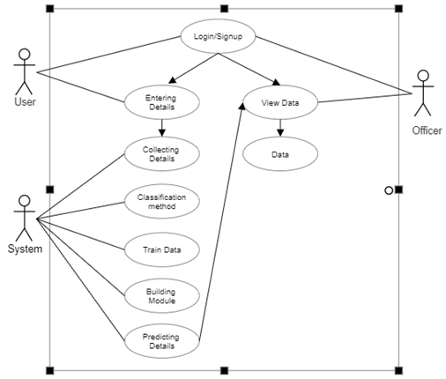
System Design
Use case diagram :

Slide 14
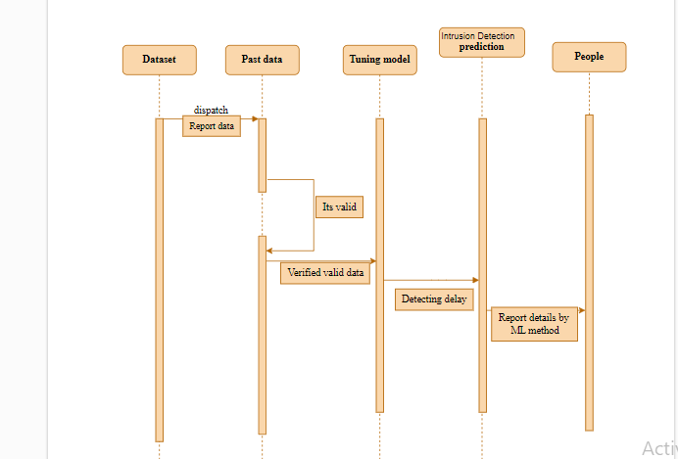
System Design - Flow Chart/DFD/ER

Slide 15
Module Description
Data Pre-processing
Data Analysis of Visualization
Implementing Support Vector Machine (SVM)
Implementing AdaBoost classifier
Implementing Random Forest Classifier
Implementing Voting Classifier
Deployment

Slide 16
Module Description
Data Pre-processing:
Validation techniques in machine learning are used to get the error rate of the Machine Learning (ML) model, which can be considered as close to the true error rate of the dataset. If the data volume is large enough to be representative of the population, you may not need the validation techniques. However, in real-world scenarios, to work with samples of data that may not be a true representative of the population of given dataset. To finding the missing value, duplicate value and description of data type whether it is float variable or integer. The sample of data used to provide an unbiased evaluation of a model fit on the training dataset while tuning model hyper parameters.

Slide 17
Module Description
Data visualization:
Data visualization is an important skill in applied statistics and machine learning. Statistics does indeed focus on quantitative descriptions and estimations of data. Data visualization provides an important suite of tools for gaining a qualitative understanding. This can be helpful when exploring and getting to know a dataset and can help with identifying patterns, corrupt data, outliers, and much more. With a little domain knowledge, data visualizations can be used to express and demonstrate key relationships in plots and charts that are more visceral and stakeholders than measures of association or significance. Data visualization and exploratory data analysis are whole fields themselves and it will recommend a deeper dive into some the books mentioned at the end.

Slide 18
Module Description
Algorithm implementation:
To consistently compare the performance of multiple machine learning algorithms, a test harness can be created using Python's scikit-learn. Resampling methods like cross validation can be used to estimate the accuracy of each model on unseen data. By visualizing the data and accuracy estimates from different perspectives, one or two best models can be chosen. This can be done using different visualization methods to show the distribution of model accuracies. Ultimately, this approach can be applied to new datasets and expanded with additional algorithms.
Support Vector Machine (SVM)
AdaBoost classifier
Random Forest Classifier
Voting Classifier

Slide 19
Testing /Performance Evaluation / Results
TEST REPORT: 01
USECASE : User/Admin Signup
TEST CASE ID | TESTCASE/ACTION TO BE PERFORMED | EXPECTED RESULT | ACTUAL RESULT | PASS/ FAIL
1 | Enter a Name & Password in the Text Box | User Created Successful | User Created Successful | Pass
2 | Enter a Name & Password in the Text Box | Enter Valid Input | Enter Valid Input | Pass

Slide 20
Testing /Performance Evaluation / Results
TEST REPORT: 02
USECASE : User/Admin Login
TEST CASE ID | TESTCASE/ACTION TO BE PERFORMED | EXPECTED RESULT | ACTUAL RESULT | PASS/ FAIL
1 | Enter a Name & Password in the Text Box | Login Successfully | Login Successfully | Pass
2 | Enter a Name & Password in the Text Box | Enter Valid Input | Enter Valid Input | Pass

Slide 21
Testing /Performance Evaluation / Results
TEST REPORT: 03
USECASE : Getting Inputs from users/Admin
TEST CASE ID | TESTCASE/ACTION TO BE PERFORMED | EXPECTED RESULT | ACTUAL RESULT | PASS/ FAIL
1 | Selecting Type of Crime from Dropdown list Box | Option Selected | Option Selected | Pass
2 | Selecting Type of Crime from Dropdown list Box | Select Valid Input | Select Valid Input | Pass
3 | Clicking Submit Button | Submitted | Submitted | Pass
4 | Clicking User Logout Button | Logout Successfully | Logout Successfully | Pass
5 | Show the Latest Report | Data Displayed | Data Displayed | Pass
6 | Show All Report | Data Displayed | Data Displayed | Pass
7 | Clicking User Logout Button | Logout Successfully | Logout Successfully | Pass

Slide 22
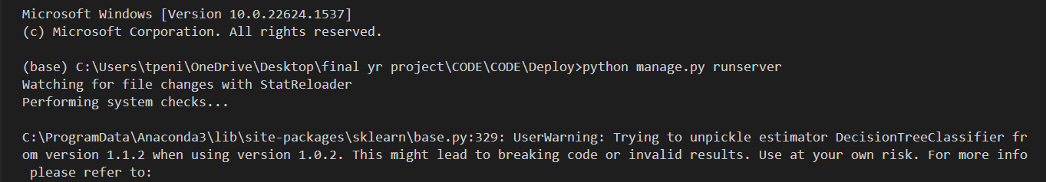
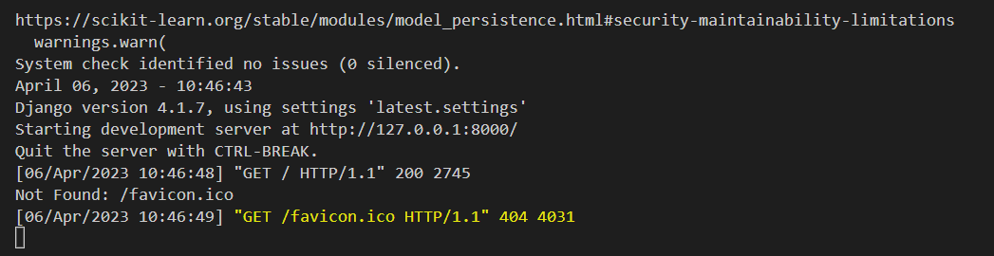
Screen Shots
In Fig 1, For deploying and run the entire program, just call and run the file manage.py in a server.
Fig 1 Deploying the Program
In Fig 2, After initializing the server press CTRL and right click the IP Address to run the program in a separate server.
Fig 2 Initializing the server

Slide 23
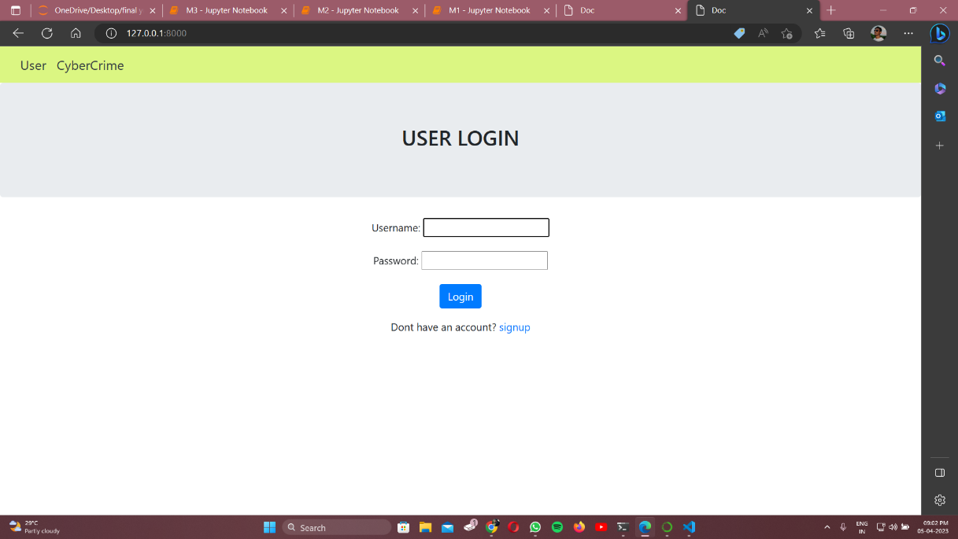
Screen Shots
In Fig 3, Enter user Login Details for new user or already existed user in Login Page.
Fig 3 User Login Page

Slide 24
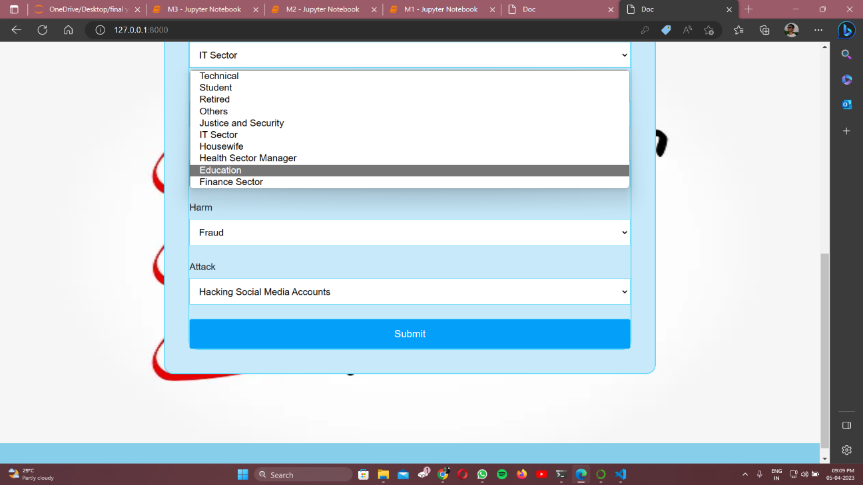
Screen Shots
In Fig 4, Now submit all the details
Fig 4 User Detail Submission

Slide 25

Screen Shots
In Fig 5, Enter user Login Details for new user or already existed user in cybercrime page
Fig 5 Officer Login Page

Slide 26

Screen Shots
In Fig 6, The Officer can check on all the data submitted.
Fig 6 Data submissions

Slide 27
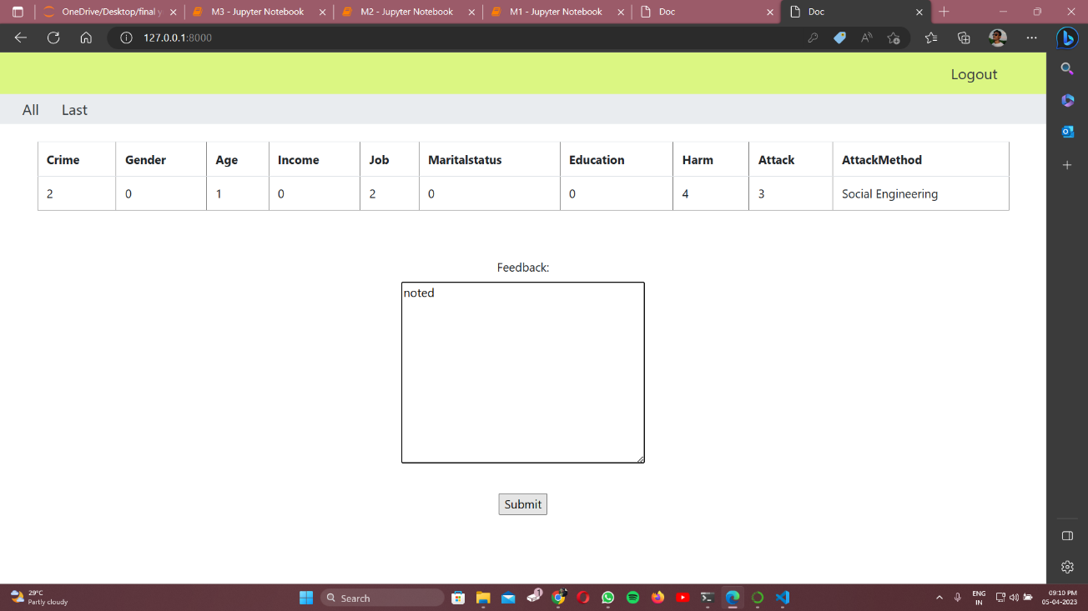
Screen Shots
In Fig 7, Send a feedback to the user's report.
Fig 7 User feedback

Slide 28
Conclusion / Feature Enhancement
Intrusion detection using machine learning is critical for cybersecurity. Proposed methodology involves various steps including data collection, preprocessing, model selection, training, evaluation, and deployment. Successful implementation can lead to reliable and efficient intrusion detection systems. Continuous monitoring and updating of the model can help organizations stay ahead of evolving threats. The analytical process includes data cleaning, processing, exploratory analysis, model building, and evaluation to find the best algorithm for identifying intrusions.
FUTURE ENHANCEMENT
Deploying the project in the cloud.
To optimize the work to implement in the IOT system.

Slide 29
Reference Paper
[1] Tchakoucht TA, Ezziyyani M. Building a fast intrusion detection system for high-speed-networks: probe and DoS attacks detection. Procedia Comput Sci. 2018;127:521–30.
[2] Zuech R, Khoshgoftaar TM, Wald R. Intrusion detection and big heterogeneous data: a survey. J Big Data. 2015;2:3.
[3] Debar H. An introduction to intrusion-detection systems. In: Proceedings of Connect, 2000. 2000.
[4] Ferhat K, Sevcan A. Big Data: controlling fraud by using machine learning libraries on Spark. Int J Appl Math Electron Comput. 2018;6(1):1–5.
[5] Manzoor MA, Morgan Y. Real-time support vector machine based network intrusion detection system using Apache Storm. In: IEEE 7th annual information technology, electronics and mobile communication conference (IEMCON), 2016. Piscataway: IEEE. 2016; p. 1–5.
[6] Vimalkumar K, Radhika N. A big data framework for intrusion detection in smart grids using Apache Spark. In: International conference on advances in computing, communications and informatics (ICACCI), 2017. Piscataway: IEEE; 2017. p. 198–204.
[7] Dahiya P, Srivastava DK. Network intrusion detection in big dataset using Spark. Procedia Comput Sci. 2018;132:253–62.
[8] Vapnik, "The Nature of Statistical Learning Theory", Springer-Verlag, New York, 1995.
[9] Bremner D, Demaine E, Erickson J, lacono J, Langerman S, Morin P, Toussaint G (2005). "Output-sensitive algorithms for computing nearest-neighbor decision boundaries". Discrete and Computational Geometry 33 (4): 593-604.
[10] Domingos, Pedro & Michael Pazzani (1997) "On the optimality of the simple Bayesian classifier under zero-one loss". Machine Learning, 29:103-137

Slide 30
Reference Paper
[11] Bradley AP. The use of the area under the ROC curve in the evaluation of machine learning algorithms. Pattern Recognit. 1997;30(7):1145–59.
[12] Rung-Ching Chen, Kai-Fan Cheng and Chia-Fen Hsieh, "Using Rough Set and Support Vector Machine for Network Intrusion Detection", International Journal of Network Security & Its Applications (IJNSA), Vol 1, No 1, 2009.
[13] Enache A-C, Sgârciu V. Enhanced intrusion detection system based on bat algorithm-support vector machine. In: 11th international conference on security and cryptography (SECRYPT), 2014. Piscataway: IEEE; 2014. p. 1–6.
[14] Bhavsar H, Ganatra A. A comparative study of training algorithms for supervised machine learning. Int J Soft Comput Eng (IJSCE). 2012;2(4):2231–307.
[15] Kulariya M. et al. Performance analysis of network intrusion detection schemes using Apache Spark. In: International conference on communication and signal processing (ICCSP), 2016. Piscataway: IEEE; 2016. p. 1973–1977.
[16] C. Leckie and R. Kotagiri. A Probabilistic Approach to Network Scan Detection. In Proceedings of the 8th

